Slide 1


Practical
Data Science & Machine Learning:
Getting Started with
Git & Github
BUS152
Spring 2024

Slide 2
Cloning Course Repo

Slide 3
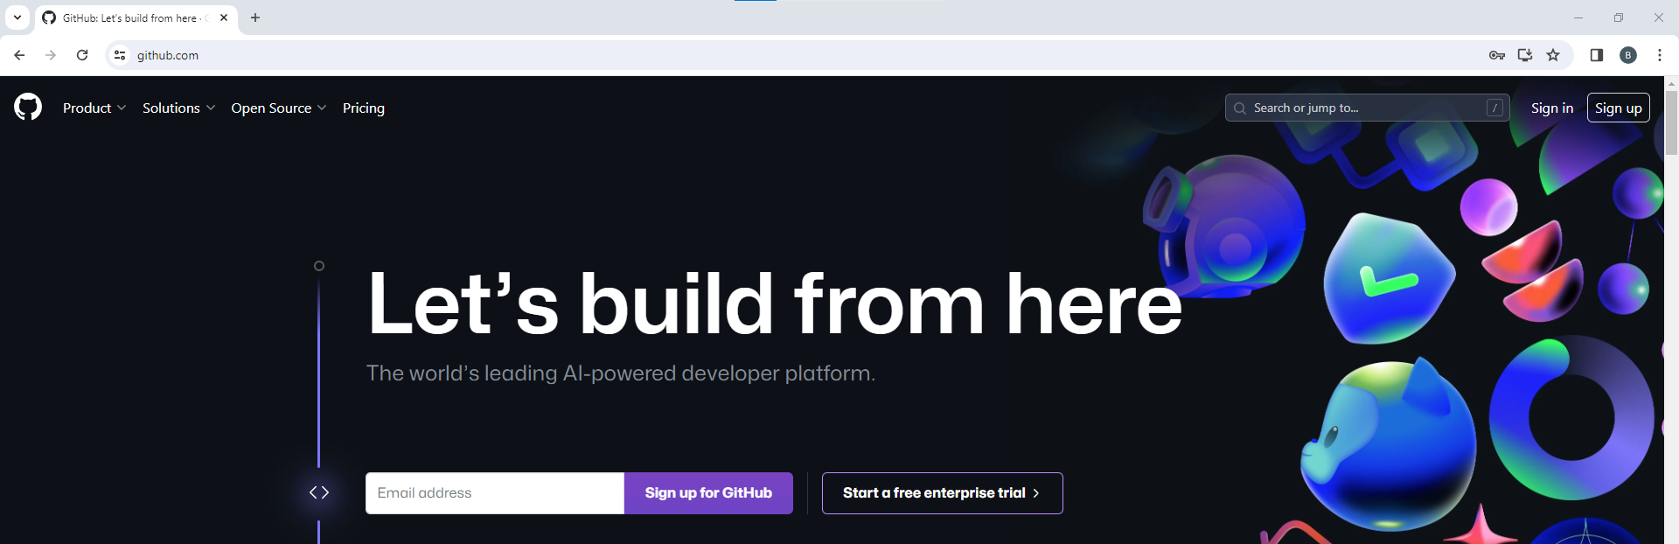
Create Personal Github Account

Slide 4
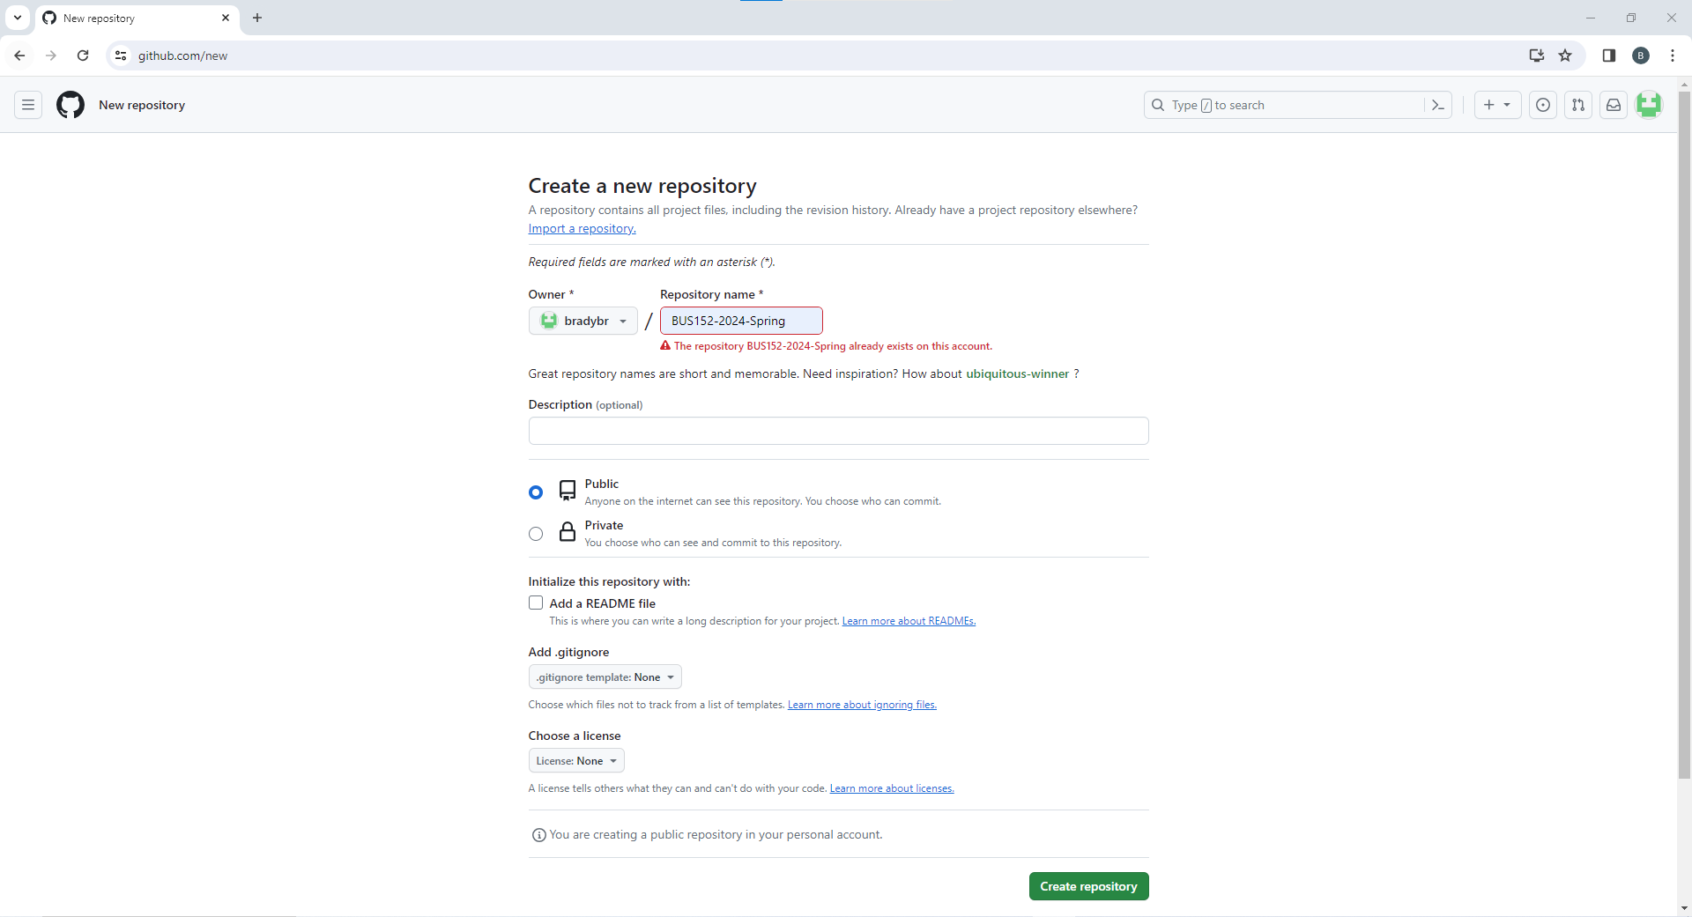
Create Empty Github Repository
Enter Repository name
BUS152-2024-Spring
Details
Public
No README file
License None

Slide 5

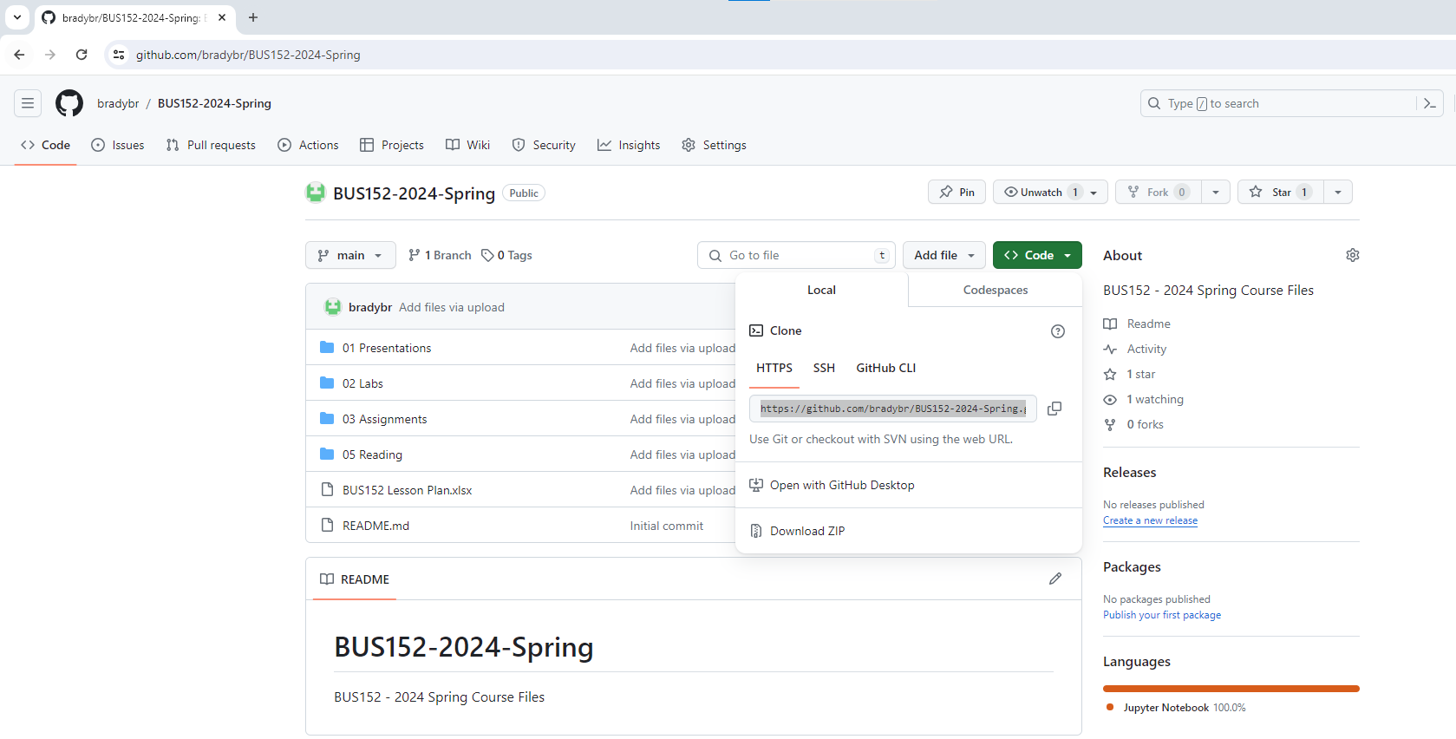
Copy Course Github URL
Go to the course repository – https://github.com/bradybr/BUS152-2024-Spring
Copy the URL under the button
https://github.com/bradybr/BUS152-2024-Spring.git

Slide 6
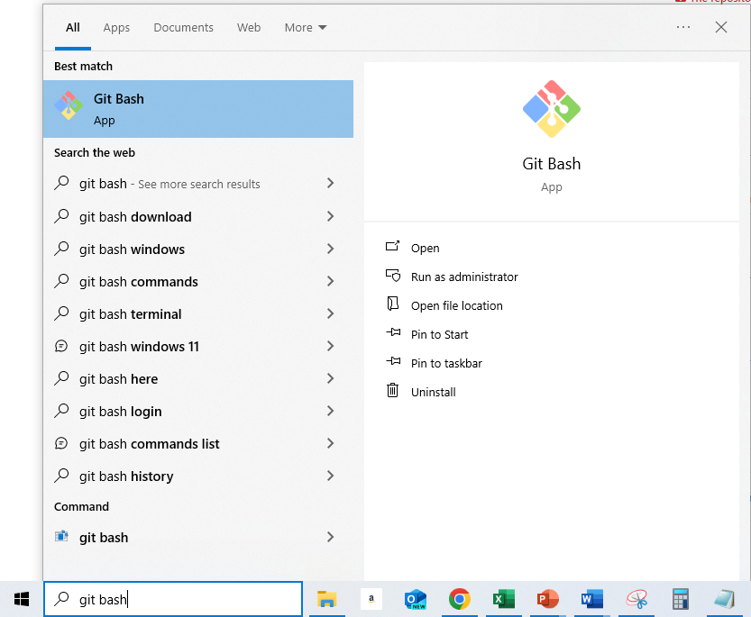

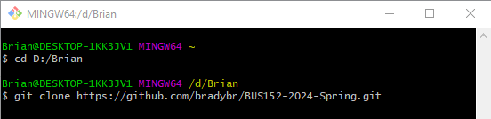
Clone
Course Files
Open the Git Bash terminal
Change directory to wherever you want your files to live
cd <your folder path>
Clone course repository
git clone <right-click paste course repository URL from previous step>

Slide 7
Pushing To Your Repo

Slide 8
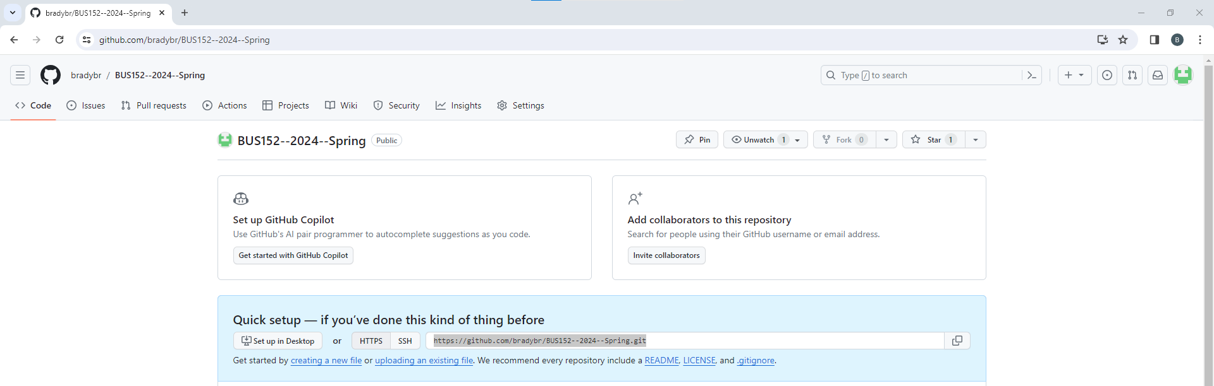
Copy Your Repository Path
Go to YOUR github course repository
https://github.com/<your account>/BUS152-2024-Spring
Copy your .git path
https://github.com/<your account>/BUS152-2024-Spring.git

Slide 9
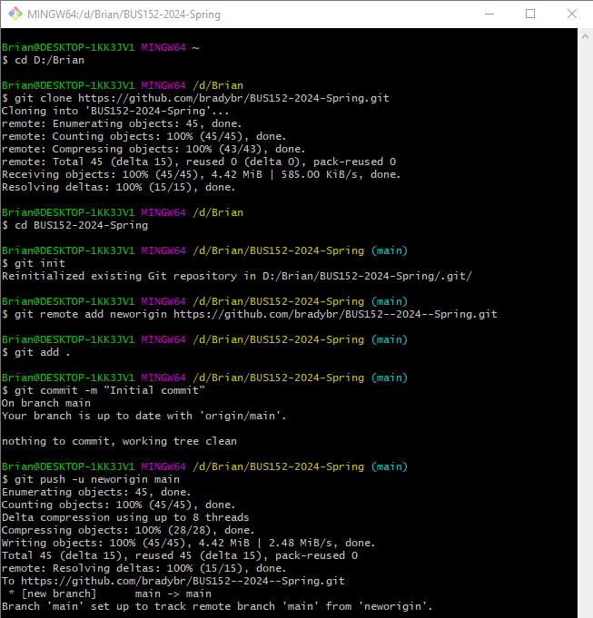
Pushing Files To Your Repository
Go to the Git Bash terminal and follow the steps below
Change directory to your new local folder where your files live
cd BUS152-2024-Spring
Initialize a local repository
git init
Add URL for the repo we want to push to
git remote add neworigin <right click paste your copied repo URL>
Add the file to the index
git add .
Commit your files
git commit –m “Initial commit”
Enter User Name & Email if prompted
git config user.name <your name>
git config user.email <your email>
Push your files to Github
git push –u neworigin main

